Slide 1
How to use grants.gov
California Governor’s Office of Planning and Research
State Clearinghouse

Slide 2
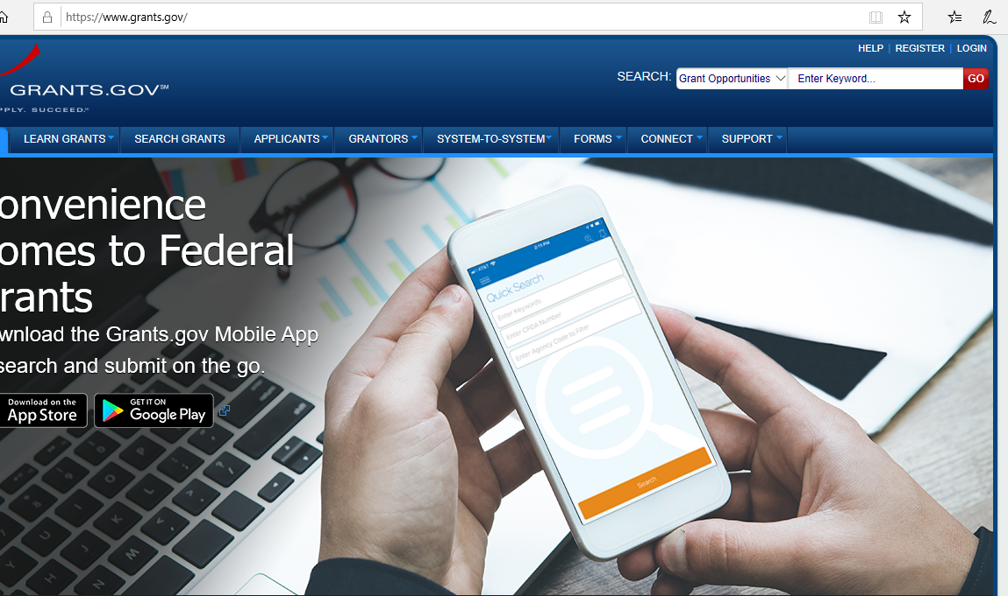
Two Ways to Search for a Grant
www.grants.gov

Slide 3
Search by keyword
www.grants.gov

Slide 4
Search tab
www.grants.gov

Slide 5
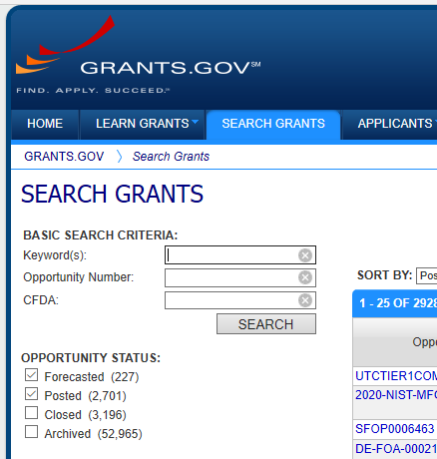
Search tab
Search by Keyword or ID number, filter by Status…

Slide 6
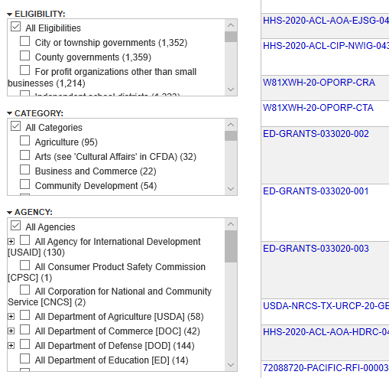
Search tab filter by applicant, category or federal agency

Slide 7
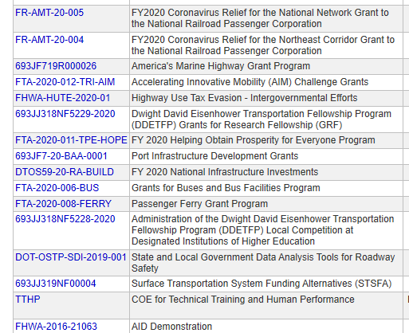
Select the Grant link for…

Slide 8
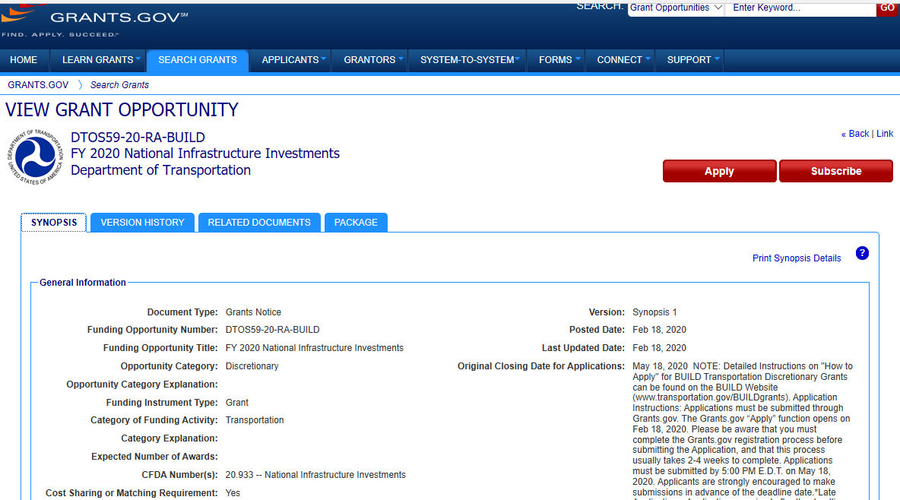
The Grant page with more info

Slide 9
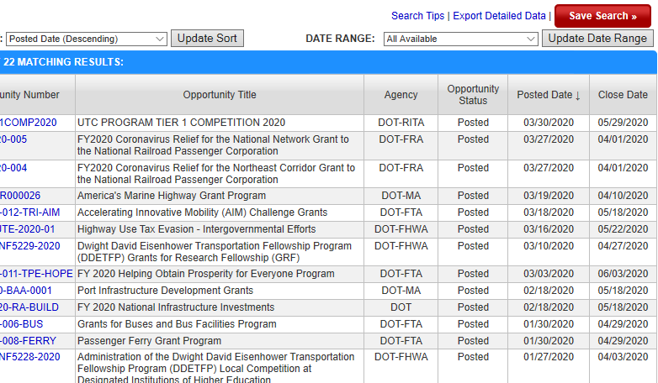
Search tab search results can be saved (for registered users)

Slide 10
Saved Searches automated email updates for new grants

