Slide 1
Technical Advisory Council Quarter 2 Meeting
Integrated Climate Adaptation and Resiliency Program
May 16, 2025, 10:00am

Slide 2
Agenda
Roll Call & Housekeeping
Approval of Draft Meeting Minutes
TAC Member Report Out
ICARP Updates and Staff Report
ICARP TAC Charter Updates
ICARP Extreme Heat and Community Resilience Grantee Spotlight
Vulnerable Communities Definition Subcommittee
Extreme Heat Action Plan
Extreme Heat Case Study from Climate Resolve
CalHeatScore
General Public Comment
Closing and Meeting Adjourned

Slide 3
Item 1 | Roll Call & Housekeeping

Slide 4
Zoom Support
For virtual attendees, technical support and other questions can be asked in the Q&A function on Zoom.
You can also reach Sam Magill by email for technical support:
  s.magill@csus.edu

Slide 5
Item 2 | Approval of Draft Meeting Minutes

Slide 6
Item 2 | Public Comment

Slide 7
ACTION
Approve the meeting minutes from the ICARP Technical Advisory Council 1st Quarter Meeting on March 7, 2024.

Slide 8
Item 3 | TAC Member Report Out

Slide 9

Good Neighbor Award 2025
Allensworth PA

Slide 10
Updates & Acknowledgements
Thank you to the Vulnerable Communities Definition Subcommittee
  Kim Clark, Denise Kadara, Jonathan Parfrey, David Loya, Clesi Bennett (Alternate), Linda Helland, ICARP Staff (Kim Danko, Cora Ballek, Ben McMahan, Azura Haley)
Department of Public Health Extreme Heat Update – Daniel Woo

Slide 11
Item 3 | Discussion

Slide 12
Item 4 | ICARP Programmatic Updates and Staff Report

Slide 13


Welcome New Staff!
Colin Green
Associate Resilience and Adaptation Planner
Slobodan (Bob) Krstic
ICARP Grant Administrative Analyst

Slide 14
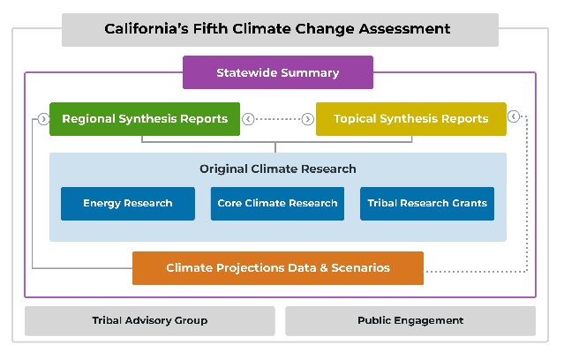
Updates – Fifth Assessment
The Fifth Assessment team received seven nominations for new Tribal Advisory Group membership to expand regional representation across the Climate Assessment regions.
All Fifth Assessment research products, including over 50 funded reports and seven State Volunteered reports, are under development.

Slide 15
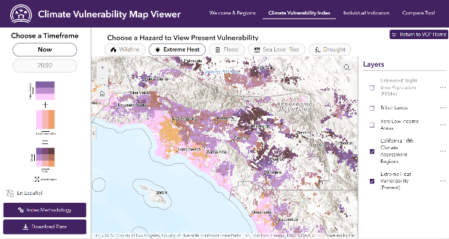
Updates – Climate Services
Climate Services continues work on the Vulnerable Communities Platform (VCP) alongside partners to help ensure reflection of the needs and priorities of the diverse communities it’s designed to serve.
The VCP is an easy-to-use tool that will help users understand what worsening wildfire, extreme heat, flooding, sea level rise, and drought will look like in California communities.

Slide 16
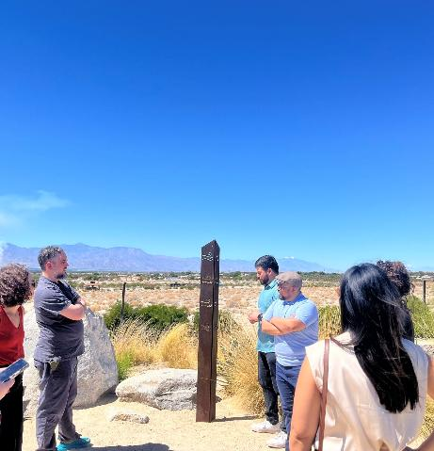
Updates – Grant Programs
Extreme Heat Team: executing 47 Round 1 grant contracts by May 31st for projects to begin this summer.
Extreme Heat Team: developing a peer learning and grantee support strategy with UCLA Luskin, Lawrence Berkeley National Labs, ICARP staff, and more.
Adaptation Planning Grant Program: completed application debriefs for 47 Round 2 applicants.
Regional Resilience Grant Program: held a technical assistance workshop on March 4th for grantees focused on community engagement.

Slide 17

Other Updates
In partnership with CalOES and federal partners, our staff co-led the development of a Recovery Needs Assessment (completed on March 8, 2025) to support recovery from the Los Angeles Wildfires. This assessment will inform opportunities to support and accelerate resilient rebuilding in Los Angeles.

Slide 18
Item 4 | Discussion

Slide 19
Item 5 | ICARP TAC Charter Updates

Slide 20
Item 5 | Discussion

Slide 21
Item 5 | Public Comment

Slide 22
ACTION: Approve the revised TAC Charter and Bylaws.

Slide 23
Item 6 | ICARP Extreme Heat and Community Resilience
Grantee Spotlight

Slide 24

Extreme Heat and Community Resilient Program Grantee Spotlight

Slide 25
Extreme Heat & Community Resilience Background
The EHCRP funds planning and implementation projects aimed to:​
Reduce the impacts of extreme heat and build community resilience​
Build frameworks for change​
Invest in local, regional, and tribal projects that strengthen communities that are vulnerable to heat

Slide 26
Round 1 Timeline
Listening sessions
Grant guidelines drafted with public comment period
Projects awarded
Contracting
Projects contracted executed
Projects complete
Strategy evaluation report
2024
2027
2023
NOFA released
Applicant Technical Assistance
Interagency Review
2025
Grantee support
Peer learning

Slide 27
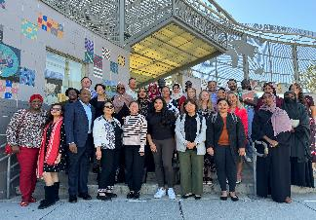

Program Development Engagement
Regional listening sessions
Office of Community Partnerships and Strategic Communications
Priority populations (Older adults, farm workers, health care etc.)
Engagement with existing state grant programs

Slide 28
Grant Program Vision
Supporting a statewide movement to build resilience to extreme heat through:
Immediate response & long-term resilience
Protecting the health of Californians who are most vulnerable to extreme heat
Community-based organization-led and strong CBO partnerships
Small grants and planning grants that build capacity towards larger investments

Slide 29
Movement Building
Small Planning Grants
Large Implementation Grants
Large Planning Grants
Small Implementation Grants

Slide 30
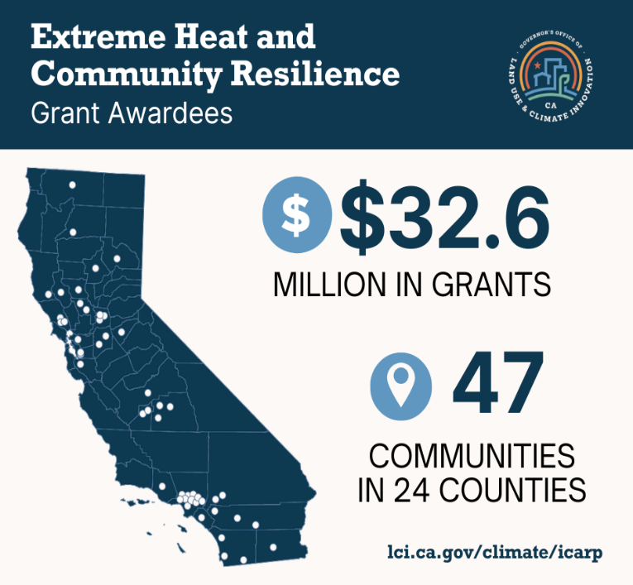
30

Slide 31
Round 1 Overview
Small Planning Grants
$100,000-$250,000
20 Grantees
Large Planning Grants
$300,000-$750,000
11 Grantees
Small Implementation Grants
$100,000-$450,000
12 Grantees
Large Implementation Grants
$500,000-$4 Million
6 Grantees

Slide 32
Planning Grants
Vulnerability Assessment and Community Tools
Extreme Heat Plans
Capacity Building & Partnership Development
Infrastructure Pre-Planning

Slide 33
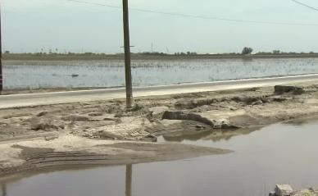
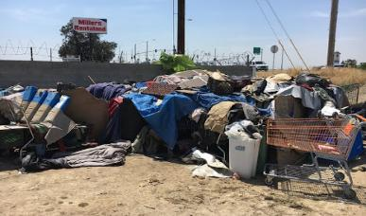
Small Planning Grants
Kings County Office of Emergency Services ($247,100)
  Creation of the Kings County Extreme Heat and Community Resilience Plan and an extreme weather sheltering plan. Includes engagement focusing on vulnerable populations including access and functional needs, non-English speakers, unhoused individuals, farmworkers, and others who rely on outdoor labor.
Kings Partnership for Prevention, Inc ($249,999.69)
  Develop a workgroup comprised of local community partners to address the impacts of extreme heat in Kings County through active engagement and fostering partnerships with community members and local government entities across the region.

Slide 34
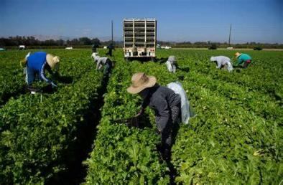
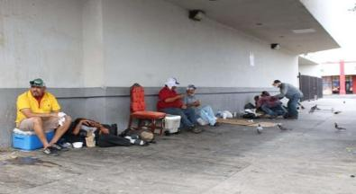
Large Planning Grants
Ventura County ($749,931)
  Create a community-driven countywide extreme heat action plan. Establish a stakeholders committee to guide the framework and community participation. Conduct a baseline heat risk assessment, identifying temperature trends, vulnerable populations, and relevant stakeholders. Explore suitable heat adaptation policies and interventions, including financial mechanisms and limitations. Pilot a heat campaign to educate vulnerable groups and health practitioners on heat induced health impacts.
Comite de Civico del Valle ($739,680)
  Develop a local heat action plan in collaboration with community organizations, local/regional governmental entities, and tribal nations. Learn from communities experienced in building heat action plans. Conduct a Climate Vulnerability Assessment. Develop a local heat action plan. Implement 1-2 demonstration projects selected in community meetings. Disseminate the heat action plan and use it as a tool for building partnerships.

Slide 35
Implementation Grants
Community Services & Response
Public Awareness & Notification
Built Environment
Nature Based Solutions

Slide 36
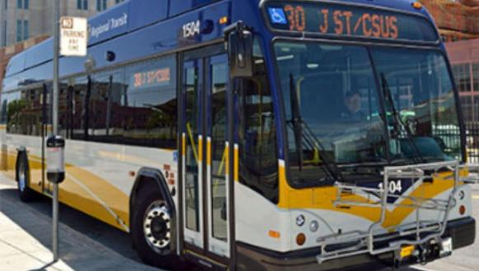
Small Implementation Grant
Sacramento Regional Transit District (SacRT) ($449,900)
  Construct and install 20 heat resilient bus stop shelters at locations identified in SacRT’s Bus Stop Improvement Plan.

Slide 37
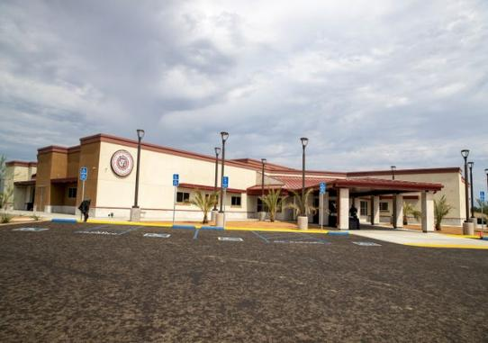
Large Implementation Grants
Torres Martinez Desert Cahuilla Indians ($3,478,434.14)
  Enhance resilience to extreme heat through clean energy solutions and sustainable land stewardship. Install a microgrid system at the community gym, integrating a 385kWdc photovoltaic system, a Battery Electric Storage System, and a backup generator. This system will ensure critical power support during outages and optimize performance through an energy management system. Collaborate with youth to plant 200 native species trees, promoting ecological benefits and landscape resilience.

Slide 38

Large Implementation Grant Awards
North Coast Opportunities ($2,339,969.98)
  Address Lake County's vulnerability to extreme heat by providing communities with safe alternatives to reduce climate change impacts. Introduce Tribal and non-Tribal residents to solar mini-split cooling/heating units. Install solar-powered mini-splits in 60 homes of senior residents and those with chronic health conditions. Increase climate-friendly workforce through on-the-job trainings and workshops and connect trained individuals to employment opportunities in the solar industry.

Slide 39
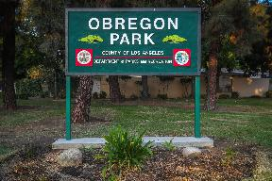
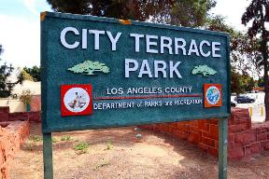
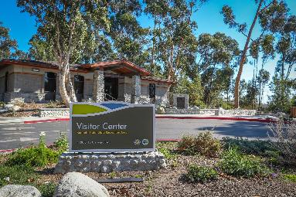
LA County Large Implementation Grant Award
County of Los Angeles Department of Parks and Recreation ($3,969,934.42)
  Enhance park resilience in the Los Angeles region to provide cooling refuge areas throughout LA County. Add cooling amenities and programs at Kenneth Hahn State Recreation Area, City Terrace Park, and Eugene A. Obregon Park. Upgrades include shade structures for fitness and playground areas, tree planting, accessible drinking and water bottle filling stations, and restroom improvements. Heat programming includes emergency preparedness classes, educational pop-up booths, and leadership programs.

Slide 40
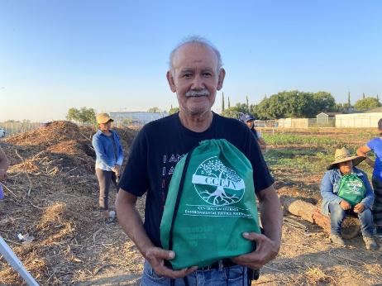
Public Health Institute
Large Implementation Grants
Public Health Institute ($2,452,661.46)
  Address extreme heat resilience at site, county, and multi-county levels. Support the development of a cooling center and resilience hub at a Tulare County school to provide refuge during extreme heat events. Build farmworker capacity to mitigate extreme heat impacts by offering resiliency training and distributing cooling kits. Facilitate a multi-county learning community across five San Joaquin Valley counties, fostering peer-to-peer learning and actions to reduce extreme heat impacts on vulnerable populations.

Slide 41
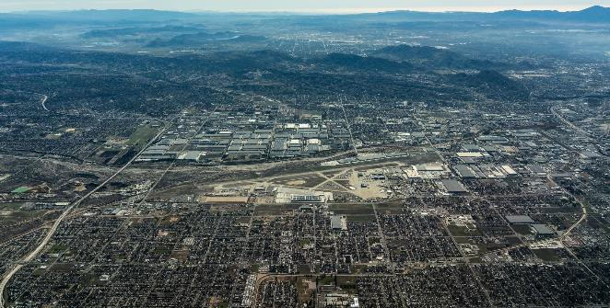
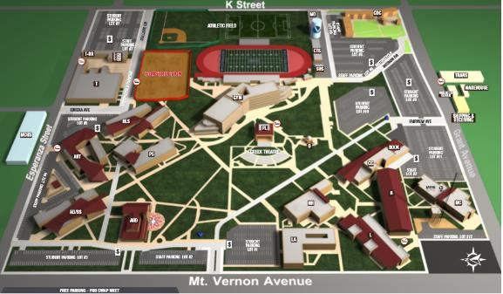
San Bernardino Planning & Implementation

Slide 42
San Bernardino Planning & Implementation Grants
Inland Empire Waterkeeper ($250,000)
  Create a community asset map that will identify existing and potential outdoor areas that can serve as natural cooling areas.
tinkercraft: Design & Advocacy Group ($106,500)
  Creation of an Extreme Heat Adaptation Toolkit. The toolkit will be compiled from guidelines, best practices, and resources that address specific local challenges and solutions.
City of San Bernardino ($175,000)
  Planning activities to build capacity, conduct pre-development activities, developing partnerships, and conducting planning activities to advance long-term resilience to the compounding effects of climate change, particularly extreme heat, on historically underserved communities in San Bernardino.
San Bernardino Community College District ($449,400)
  Provide shade structures, an urban tree canopy, solar-powered collaboration tables, and tree-lined pathways to the west side of the Campus Center Building. Install 13 water bottle hydration stations across SBVC’s campus, strategically located in high-traffic areas and near classrooms.

Slide 43
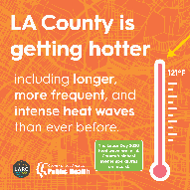
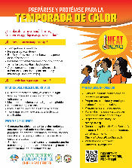
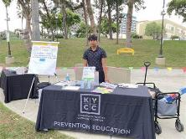
Los Angeles County
County
Cooling Amenities and Programs in LA County Parks
Public Health Department – Assessing and Preparing at-risk Communities for Heat-related impacts
City
First Heat Action and Resilience Plan
Schools
Fremont School Multi-benefit School Greening
Hart Elementary School Upgrade Project
Neighborhood
Koreatown Environmental Equity Project
Florence Firestone Bus Shelter Project

Slide 44
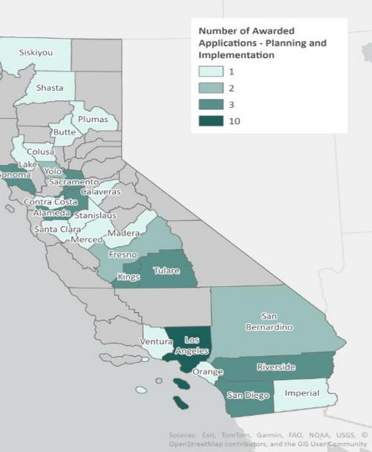
Round 1 Awards

Slide 45
Lessons Learned
Impact on listening sessions on programs
Four grant types allow program to meet community needs
Deep commitment to project development with community-based organizations
Support communities that are in the early stages of their heat work

Slide 46
Future Rounds
Focus on infrastructure (Prop 4 and GGRF dollars)
Continue to center partnerships and community engagement
Diverse funding sources (Including Aliso Canyon funding)
Continued investment in application technical assistance
Strategy evaluation and continuous learning
Continue to increase geographic diversity

Slide 47
Future Rounds Timeline
Aliso Canyon Round
Round 1 Projects Begin
2026
2028
Round 2
2027
Round 3
2030
2025

Slide 48
Round 2 Timeline
Listening sessions
Grant guidelines updated
NOFA released
Projects begin
Projects completed
2026
Interagency Review
Awards
2027
Grantee support
Peer learning
2025
2030

Slide 49
Thank You!
CONTACT
STAY CONNECTD
braden.kay@lci.ca.gov
LEARN MORE AT
lci.ca.gov/climate/icarp/grants/extreme-heat-community-resilience.html

Slide 50
Item 6 | Discussion

Slide 51
LUNCH BREAK

Slide 52
Item 7 | Vulnerable Communities Definition Subcommittee

Slide 53
Current Vulnerable Communities Definition
Climate vulnerability describes the degree to which natural, built, and human systems are at risk of exposure to climate change impacts. Vulnerable communities experience heightened risk and increased sensitivity to climate change and have less capacity and fewer resources to cope with, adapt to, or recover from climate impacts. These disproportionate effects are caused by physical (built and environmental), social, political, and/ or economic factor(s), which are exacerbated by climate impacts. These factors include, but are not limited to, race, class, sexual orientation and identification, national origin, income inequality, and disability.

Slide 54
Why Update the Definition?
Women and Gender Minorities experience disproportionate and unique impacts from climate change
  “Gender Minority:” transgender, intersex, nonbinary, agender, two-spirit, and other gender diverse people
The interaction between gender and climate impacts is a common knowledge gap, including for practitioners
Transgender people are increasingly being unfairly targeted by the current federal government and by state governments across the U.S.
The Vulnerable Communities Definition guides climate adaptation efforts throughout California by practitioners, TAC, and ICARP.
Notes:
Statistic: In 2021, a record 143 anti-trans bills were considered across the U.S., and 18 were passed. The number has risen steadily every year since then. In 2025 SO FAR, 886 anti-trans bills have been introduced across the U.S., including 44 federal bills, and 97 have passed across 22 states. This makes openly addressing the needs of transgender people even more important.
VC definition: a vehicle for setting climate adaptation priorities and ensuring that the needs of vulnerable communities are met.

Slide 55
Subcommittee Workplan
Research
Feedback
Findings
Consultation
Researched impacts of climate change on women and gender minorities
Engaged in consultation sessions with CDPH, advocacy, and community-based organizations on climate vulnerabilities
Sought feedback on Vulnerable Communities Definition
Weighed options and developed findings for the ICARP-TAC
Notes:
Assembled a subcommittee consisting of TAC members (N=6) , TAC alternates (N=1), and LCI staff (N=4)

Slide 56
Climate Impacts on Women
Women experience unique and disproportionate health impacts from climate disasters, including:
Greater reduction in life expectancy compared to men
Higher risk of dying and hospitalization for mental health in extreme heat
Higher risk of hospitalization from wildfire smoke among elderly women compared to elderly men
Rates of domestic violence, sexual violence and abuse, and trafficking spike during and after disasters
Greater long-term mental health impacts from natural disasters
Lower reported household preparedness for emergencies compared to men
Notes:
Mental health hospitalizations in EH: CA study
Domestic violence, sexual violence, trafficking: not exclusive to women. Also a problem for other genders – can happen to anyone. Particular focus in literature looking at climate impacts to women.
Mental health from natural disasters: Hurricane Katrina – long term depression and psychological distress (3 years). Also true for Black survey respondents and ppl with lower educational attainment – importance of intersectionality
HH preparedness: especially if divorced, widowed, and/or living with children

Slide 57
Climate Impacts on People Who Give Birth and Their Children
People of all genders who give birth, as well as their children, face health impacts and adverse outcomes from climate disasters:
Higher temperatures are linked to stillbirths, preterm delivery, and low birthweight
Wildfire smoke exposure is linked to preterm delivery and low birthweight
Hurricane exposure can lead to higher fetal distress rates and increase risk of postpartum depression, particularly for Black mothers
Notes:
Ppl who give birth: can be women, transgender men, nonbinary folks, intersex people, etc.
Hurricanes: important to CA due to changing weather patterns – Hurricane Hilary not technically a Hurricane when it hit CA but close. Also indicative of impacts from other comparable natural disasters

Slide 58
Climate Impacts on Gender Minorities
Gender minorities experience unique and disproportionate impacts during climate disasters, many stemming directly from discrimination:
Refused access to resources (food, water, shelter, healthcare, hygiene supplies, financial and legal support) based on gender
Increased risk of gender-based violence at emergency shelters (“corrective rape,” arrests, separation from partners)
Much higher rate of displacement due to natural disasters
Interrupted medical/social transitions; forced into/out of the closet to access support
Communities assigned low priority in recovery efforts, not acknowledged by healthcare & emergency response organizations
Adverse mental health impacts, especially among displaced & indigenous people
Lack of research on climate impacts to gender minorities outside of natural disasters
Notes:
“Corrective rape”: perpetrated against someone on the basis of their sexual orientation or gender identity. Intended to force the victim to conform to heterosexuality or normative gender identity.
Emergency shelters: 2015 U.S. Transgender Survey: 70% of transgender people seeking shelter had been turned away, were physically or sexually assaulted, or faced some other form of abuse at an assistance shelter because of their gender.
Displacement: US Census Household Pulse Survey: 2.4% of LGBTQ+ individuals were displaced compared to 1.4% of heterosexual cisgender people in 2022-23
Low priority & lack of acknowledgement: including in data collection -> distrust
Other climate impacts that could be researched: green transition, childcare burden, extreme heat, vector-borne diseases, etc.

Slide 59




Consultation Sessions

Slide 60

Consultation Sessions for Vulnerable Communities Definition
Intersectionality heightens impacts for communities
Knowledge gaps make addressing disproportionate effects of climate change on women and gender minorities difficult
1 in 3 women-led households are energy burdened and 2 in 3 are rent burdened
Women spend twice as much time as men caring for children, which is exacerbated during climate disasters
Women are paid just 66 cents for every dollar paid to white men. Green transition jobs disproportionately go to white men.
Gender minorities experience disproportionate societal harms related to safety, healthcare, challenges to rights, discrimination and hate, PTSD, hiring practices, lack of safety at home, targeting by law enforcement, and lack of safe spaces
People who are both trans & neurodivergent have extra fear and are often scared to access the help they need
Notes:
REPRESENT BROADER IMPACTS THAT EXASCERBATE CLIMATE VULNERABILITY; CLIMATE WORK ISN”T ONLY SPACE TO ADDRESS THESE; DISASTER RESPONSE IS KEY

Slide 61
Feedback on Vulnerable Communities Definition
Include:
“Gender” or “gender identity”, not both
“Gender and/or identity”
“Sex and gender identity”
“Gender” or “gender and gender identity”
Add statement on intersectionality
Exclude:
“Sex"
“Gender identity” alone
“Identification”
Notes:
EVEN AMONGST EXPERTS THERE’S CONFLICTING OPINIONS
Not both – false impression that gender = cis, gender identity = not cis
And/or ID: includes agender folks
Sex and gender ID: education code
Gender or gender + gender ID: mirrors international language, cis women may think “gender identity” alone doesn’t include them
Exclude: sex – historic & current harms to trans community (misunderstanding of sex as immutable); gender ID alone bc it could be seen as leaving out women, “identification” in connection to sexuality bc no one says that

Slide 62
Subcommittee Survey Results
No
Preference
No
Preference
No
Preference
No
No
Yes
100%
9%
Yes
18%
9%
18%
27%
18%
Yes
36%
No
73%
No
45%
Yes
64%
Yes
82%
Include
GENDER
100% Yes
Include
GENDER IDENTITY
73% No
Include
SEX
45% No
Exclude
IDENTIFICATION
64% Yes
Include
INTERSECTIONALITY
82% Yes
Notes:
Starting point of conversation among Subcommittee
N = 11,

Slide 63
Subcommittee Discussion
Factors such as these do not exist in isolation; rather, they intersect to create unique and compounded vulnerabilities. As a result, individuals facing multiple forms of systemic disadvantage often experience the most severe climate impacts and the greatest barriers to resilience.
OPTION #1
People facing multiple forms of marginalization and inequality will experience climate change impacts more intensely and face more barriers to recovery.
OPTION #2
Notes:
Selected: option 2

Slide 64
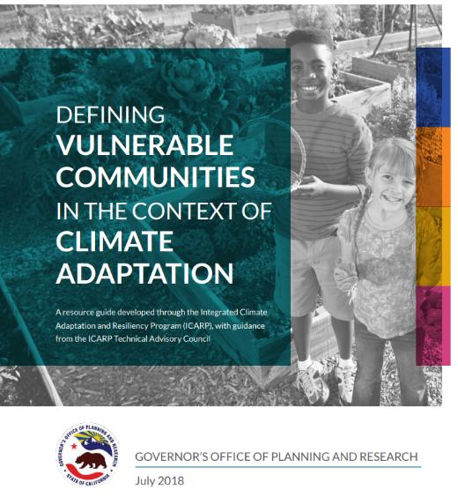
Findings
Include “gender”
Exclude “sex” and “gender identity”
Remove “identification” when referring to sexual orientation
Include statement on intersectionality
Include broader discussion of climate impacts for women and gender minorities as well as intersex people in a forthcoming update to the “Defining Vulnerable Communities” document

Slide 65
Proposed Definition Revision
  Climate vulnerability describes the degree to which natural, built, and human systems are at risk of exposure to climate change impacts. Vulnerable communities experience heightened risk and increased sensitivity to climate change and have less capacity and fewer resources to cope with, adapt to, or recover from climate impacts. These disproportionate effects are caused by physical (built and environmental), social, political, and/ or economic factor(s), which are exacerbated by climate impacts. These factors include, but are not limited to, race, class, gender, sexual orientation and identification, national origin, and income inequality. People facing multiple forms of marginalization and inequality will experience climate change impacts more intensely and face more barriers to recovery.

Slide 66
Item 7 | Discussion

Slide 67
Item 7 | Public Comment

Slide 68
ACTION: Approve the update to the vulnerable communities definition

Slide 69
Item 8 | Extreme Heat Action Plan

Slide 70



Extreme Heat Action Plan Update
May 2025

Slide 71
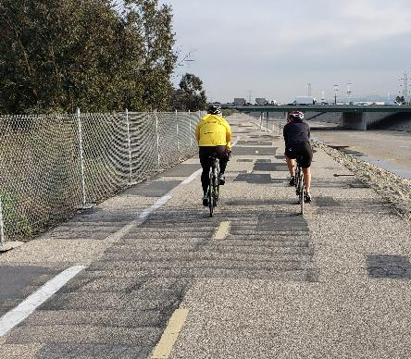
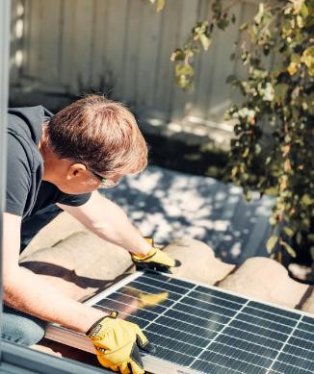
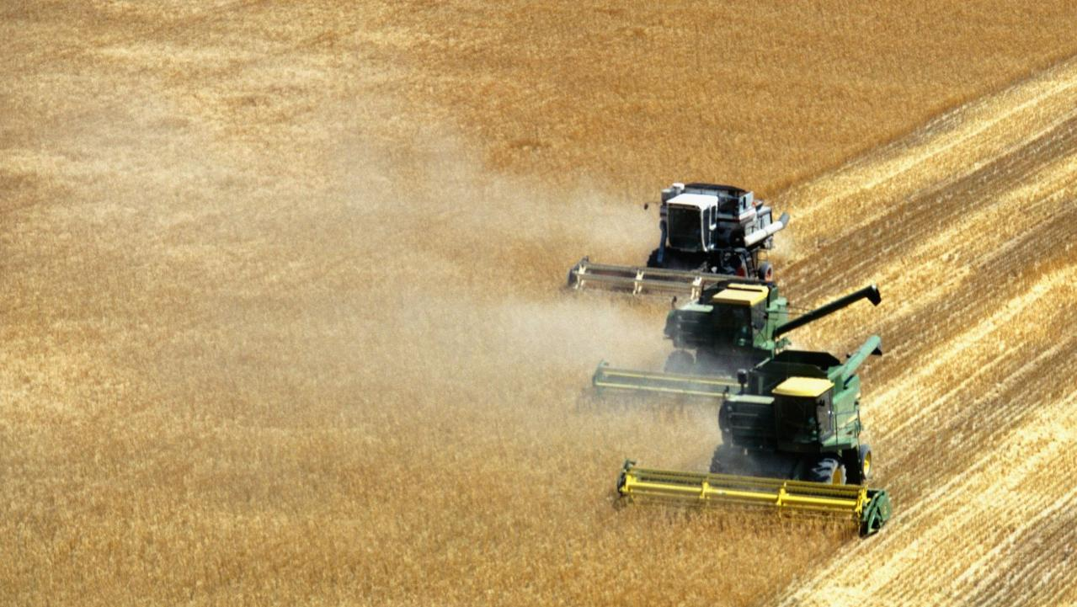
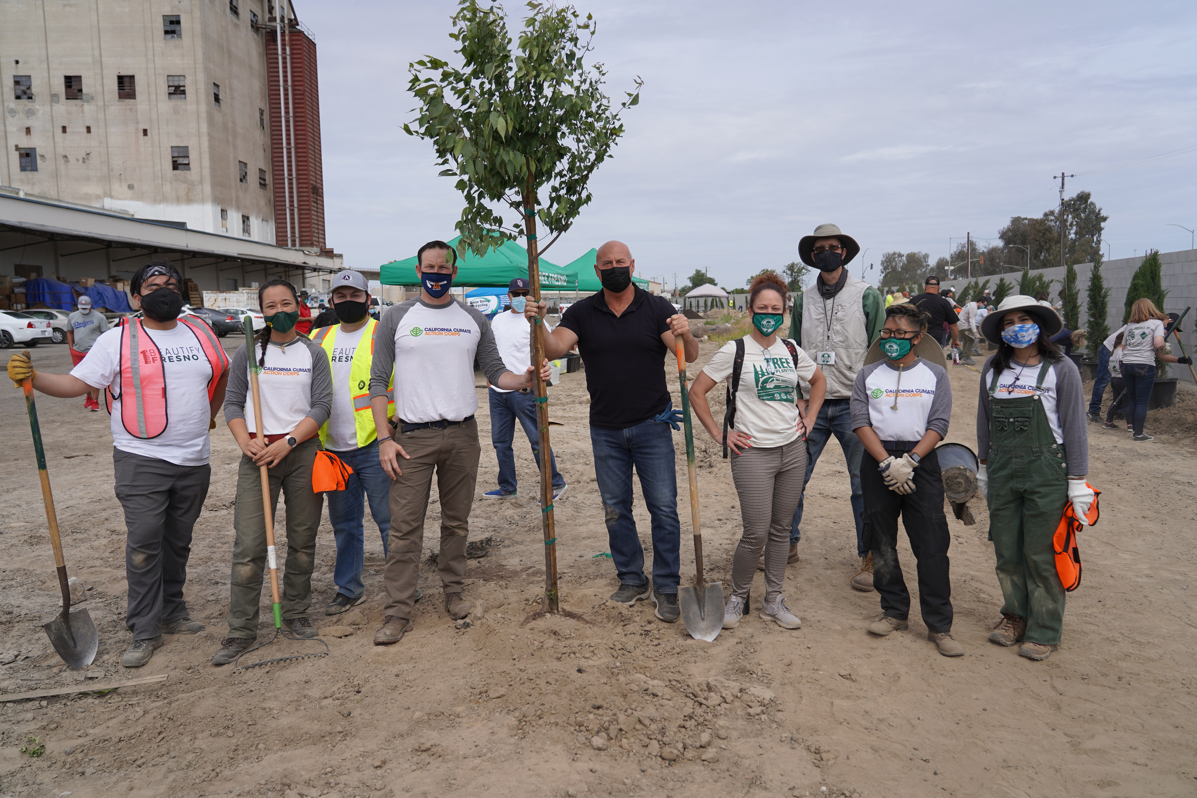
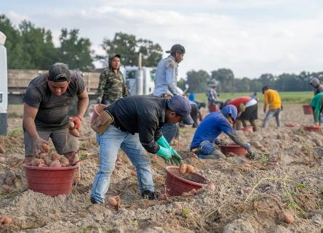
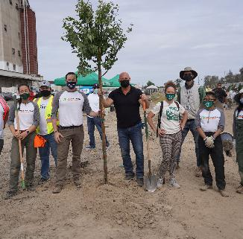
Background
Background
The 2022 Extreme Heat Action Plan provides a strategic and comprehensive set of state actions to adapt and build resilience to extreme heat. It outlines California’s all-of-government approach to mitigating the health, economic, cultural, ecological, and social impacts of increasing average temperatures and heat waves.

Slide 72
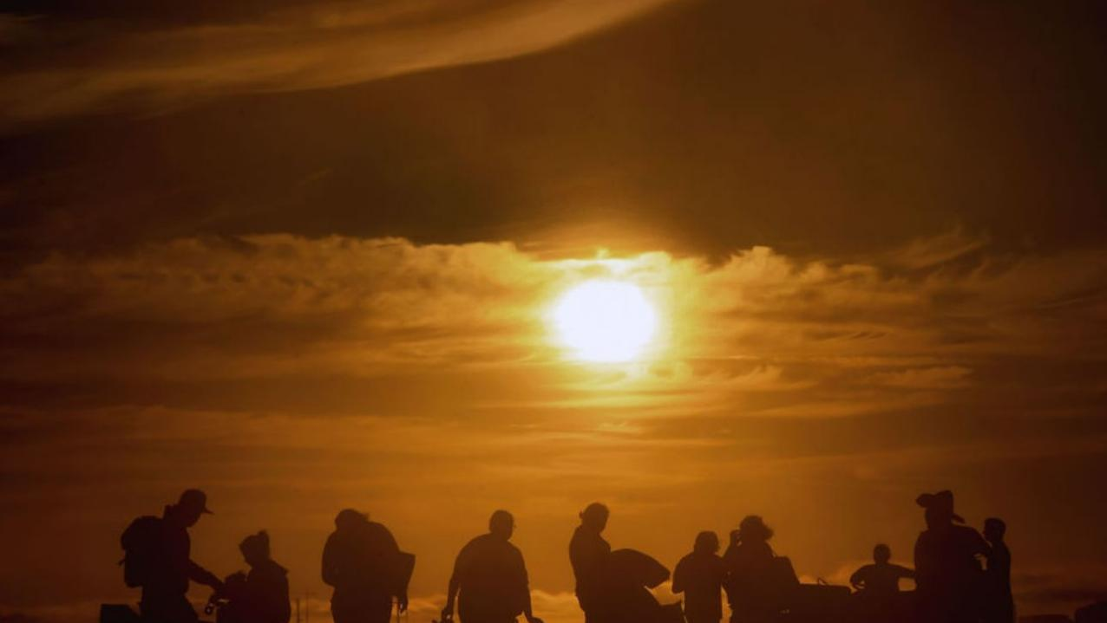
All-of-Government Approach
  CA Natural Resources Agency
  Governor’s Office of Land Use and Climate Innovation
  CA Environmental Protection Agency
  CA Department of Food and Agriculture
  CA Health and Human Services Agency
  CA State Transportation Agency
  Governor's Office of Business and Economic Development
  Governor’s Office of Emergency Services
  CA Business, Consumer Services and Housing Agency
  CA Labor and Workforce Development Agency
  California Volunteers

Slide 73



Action Tracks
Track 1: Build Public Awareness and Notification
Goal 1: Build public awareness about extreme heat through targeted communications and campaigns
Goal 2: Support actionable climate science and research to inform risk assessments and decision-making
Goal 3: Improve accuracy and accessibility of heat modeling and data to inform decision-makers
Track 2: Strengthen Community Services and Response
Goal 1: Invest in social resilience
Goal 2: Protect California’s workers and economy from the impacts of extreme heat
Goal 3: Support local planning and response measures to extreme heat events
Notes:
Thank you to attendees, speakers, facilitators and notetakers!
As we wrap up today’s workshop, we’d like to revisit the action tracks we listed at the beginning of our workshop.
As you look at these categories, are there critical aspects of extreme heat response and adaptation that you do not feel are addressed?

Slide 74


Action Tracks (cont.)
Track 3: Increase Resilience of Our Built Environment
Goal 1: Protect critical infrastructure
Goal 2: Support heat resilient and cooler communities through relevant regulations and codes
Goal 3: Invest in cool buildings and surfaces
Goal 4: Utilize science-based frameworks and tools
Track 4: Utilize Nature-based Solutions
Goal 1: Promote nature-based solutions to reduce extreme heat risks
Goal 2: Support nature’s ability to withstand and adapt to increasing temperatures
Goal 3: Reduce heat risk to water supply and systems
Notes:
Thank you to attendees, speakers, facilitators and notetakers!
As we wrap up today’s workshop, we’d like to revisit the action tracks we listed at the beginning of our workshop.
As you look at these categories, are there critical aspects of extreme heat response and adaptation that you do not feel are addressed?

Slide 75

2026 Extreme Heat Action Plan
Staffing and Prep Work
Interagency Collaboration
Public Engagement and Outreach
Draft EHAP Update
Public Comment and Revision
Finalize EHAP Update
Release EHAP Update
As specified in SB 306, the Extreme Heat Action Plan is to be updated every three years, and the next iteration of the Plan will be published on July 1st, 2026.

Slide 76
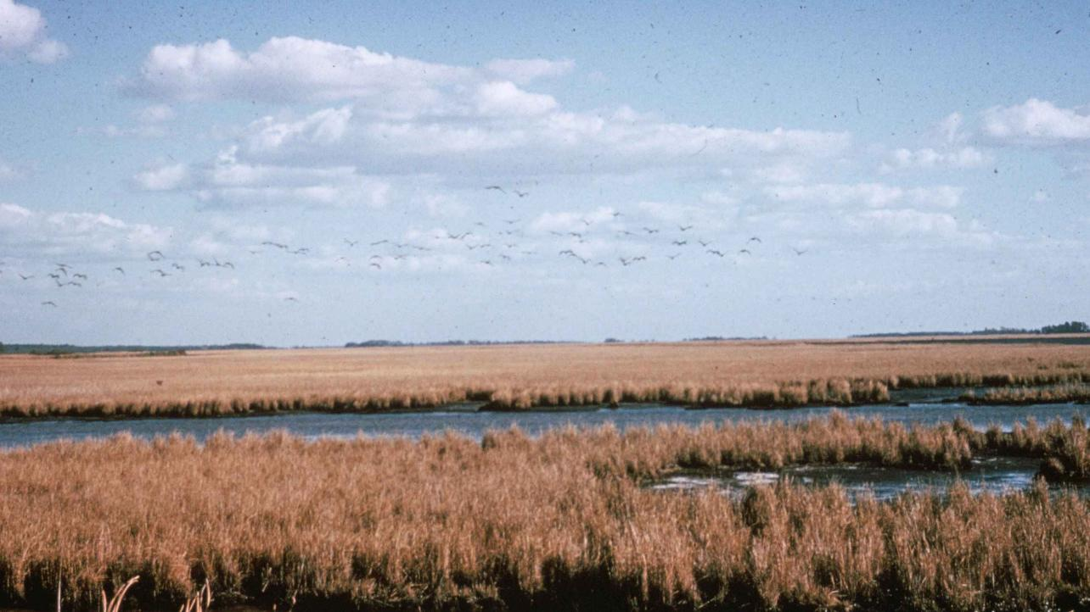
Discussion Questions
What does success look like for the Extreme Heat Action Plan Update?
How can we best engage the public on the Extreme Heat Action Plan Update?
Are there any specific points of progress made between 2022 and 2026 that are particularly important or meaningful to you?
Were there any critical gaps in the 2022 Extreme Heat Action Plan that you would like to see addressed in the 2026 Update?
How can we make the 2026 Extreme Heat Action Plan more useful and relevant for you?

Slide 77

Thank you!
Notes:
Keep up to date on the Extreme Heat Framework and the 2021 State Adaptation Strategy Update on CNRA’s website.
Have any insight or questions, please e-mail icarp@opr.ca.gov.
(Thank everyone again), Good evening.

Slide 78
Item 8 | Discussion

Slide 79
Item 9 | Extreme Heat Case Study from Climate Resolve

Slide 80


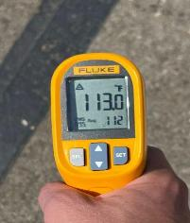
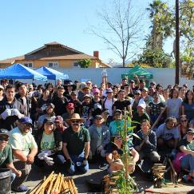
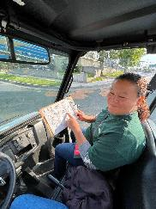
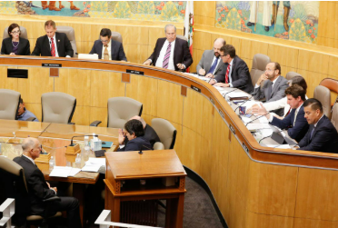
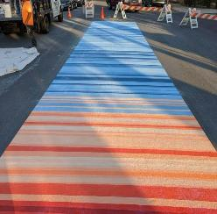
Extreme Heat Case Studies
Working with Communities to
Feed Upward Solutions
Equity
Empowerment
Policy
Innovations
Notes:
Jonathan (1 minute)

Slide 81

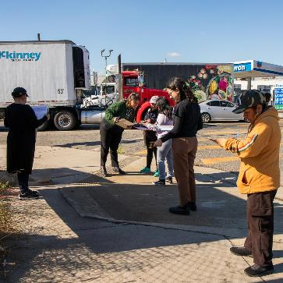
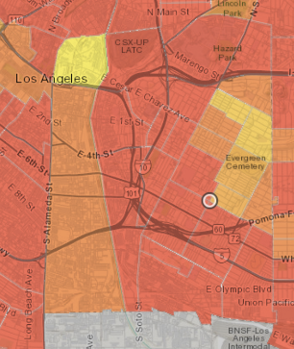
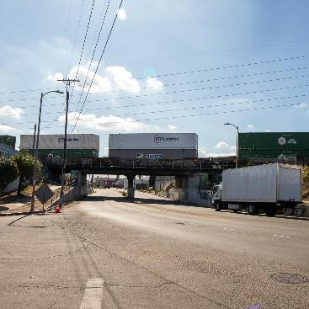
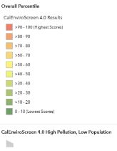
COMMUNITY ENGAGEMENT
Boyle Heights — Everyday Life
Notes:
Cat (4 minutes [11 minutes total])

Slide 82

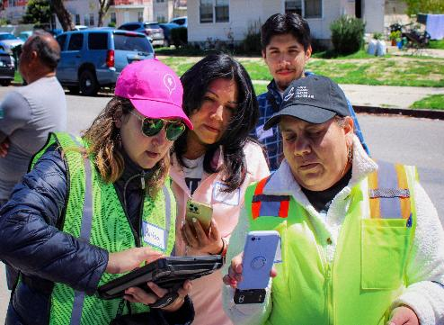
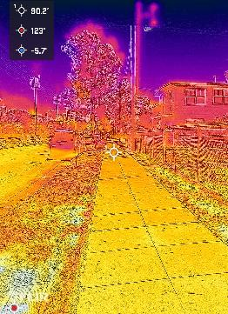
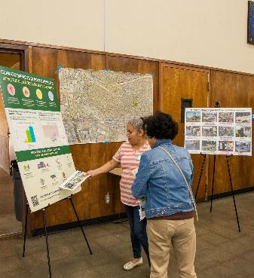
COMMUNITY ENGAGEMENT:
Boyle Heights- Building Community
Notes:
Cat (4 minutes)

Slide 83

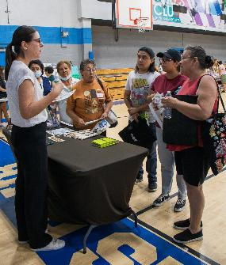
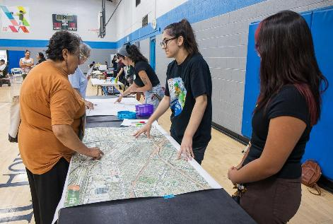
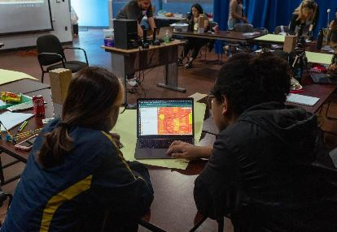
COMMUNITY ENGAGEMENT (cont.)
Boyle Heights Buffer Zone - Challenges Identified
Pic 2: Community not prioritizing climate change
Notes:
Cat (4 minutes)

Slide 84



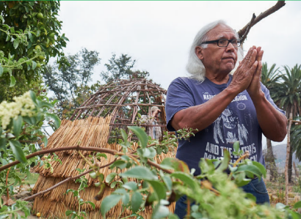
POLICY & PROGRAMMATIC INITIATIVES
Closing the Divide
Technical Assistance
Ready for Tomorrow
The Fernandeño Tataviam
Band of Mission Indians
Legislation and Policy
Programs
Budgets
Photo by Jayrol Photography. Courtesy of FTMBI
Notes:
Enrique (2 minutes [8 minutes])

Slide 85
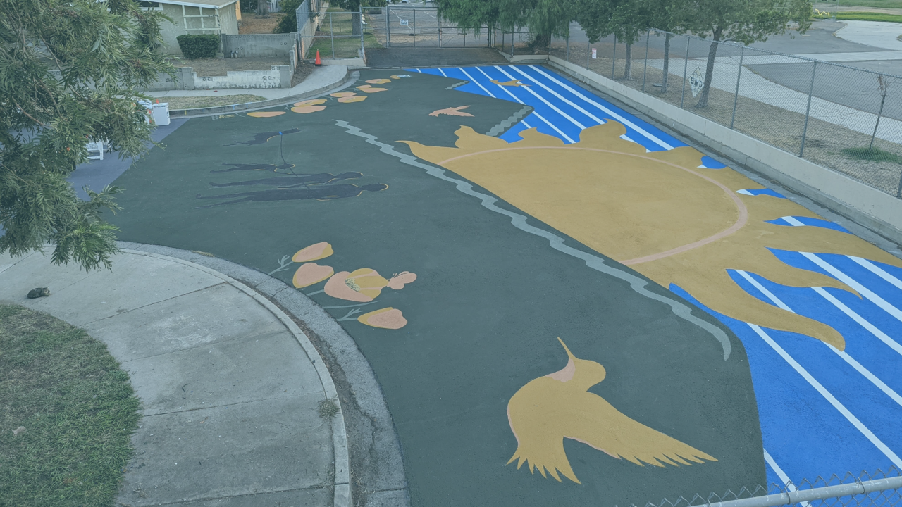
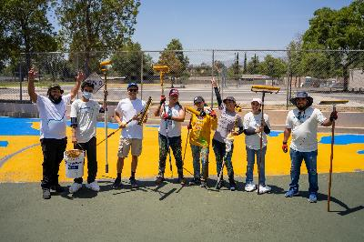

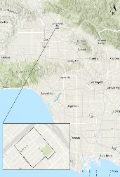
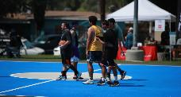

ONE MORE TOOL IN THE TOOLBOX
Pacoima Cool Communities Project
GAF StreetBond DuraShield Coatings placed in an 18-block area of Pacoima – equating to over 700K square feet of pavement and hardscapes.
Notes:
Enrique (2 minutes)

Slide 86







Research Study & Findings
ECOSTRESS LST (30m)
~10°F cooling
86

Slide 87


STORYTELLING
To Spread a Cool Message
Notes:
Enrique (4 minutes)

Slide 88

THANK YOU
Community Engagement Cbaltazar@climateresolve.org
Ready for Tomorrow / Tribes Keclarino@climateresolve.org
Pacoima Cool Community / Shine On Smelgoza@climateresolve.org
State Policy and Legislation Ehuerta@climateresolve.org
Notes:
Enrique

Slide 89
Item 9 | Discussion

Slide 90
Item 10 | CalHeatScore

Slide 91



CalHeatScore
The California Communities Extreme Heat Scoring System
California Environmental Protection Agency
Office of Environmental Health Hazard Assessment
ICARP TAC
May 16, 2025

Slide 92


Extreme Heat
Deadliest climate hazard, vulnerable groups impacted most
Heat wave seasons in the US have lengthened in recent decades (bottom right)
Longer, more intense heat seasons to come
Vulnerable Populations | weather.gov
Climate Change Indicators: Heat Waves | US EPA
Notes:
FRAMING
Extreme heat is the deadliest climate hazard, and although heat does impact everyone, impacts to vulnerable are disproportionate
This map shows increases in heat seasons throughout the US, larger circles represent bigger increases.
And, the best available climate science tells us that longer and more intense heat seasons are to come

Slide 93






An Early Warning System for Heat
Notes:
Extreme heat is a “silent killer”: it doesn’t have scenes of catastrophe like wildfires and hurricanes.
Also, there is general low awareness and preparation of the dangers of extreme heat to communities and individuals.
One of the key recommendations from CA’s climate insurance working group was to develop an extreme heat early warning system for California, in order to increase awareness of extreme heat events, allow people to prepare for extreme heat, with our ultimate goal of reducing heat related illnesses and deaths throughout the state.
This is what CalHeatScore is, a science-based tool positioned to protect CA’s most vulnerable to heat
This aligns with OEHHA’s mission to perform scientific evaluations to protect people, especially those most vulnerable, to exposures

Slide 94


Climate and Weather Data
Historical climate data
  Zip code level heat conditions
  Connect temperature measurements to health responses
Daily weather forecasts
  Temperature forecasts for the upcoming week
Notes:
Now I’ll briefly describe the datasets that make up the core of CalHeatScore.
We rely on both historical climate and weather forecast data.
We look at historical climate data to calculate, per ZIP code, what are average heat conditions throughout the year typically? This allows us to measure climate variability throughout CA.
We also use weather forecast data from our partners at NOAA to get a sense of how hot today will be, or the coming days.

Slide 95

Heat-Health Response Data
Measure risk of daily heat-related Emergency Department (ED) visits per zip code, 2016-2018
Includes heat illness, heat stroke, dehydration, acute renal failure
Source: Department of Healthcare Access and Information (HCAI)
Image source: Signs of Heat Illness
Notes:
However, the unique part of CalHeatScore, what sets it apart from a basic weather app is that we also use health data.
This allows us to measure community health response to extreme heat. We use emergency department data and measure how many people are getting sick and going to the ED with symptoms related to heat, like the ones shown on this slide.
Different communities have differing levels of vulnerability to extreme heat, and this data allows us to represent that variability throughout California.

Slide 96

Calculating Heat Rankings
Example Zip Code
Notes:
When we pull all of this data together, we’re able to understand what community health response is to increasing temperatures, at every community in California.
This chart shows a single example ZIP code in CA. Our data shows us that when temperatures rise, what the expected increased risk of excess ED visits is over baseline.
In this community, temperatures of about 87 degrees result in typical ED rates. However, when they rise to 94, there’s a 33% spike in visits. At 98, a 67% increase, and at 102, a 100% increase – or double the amount of ED visits related to heat compared to normal conditions.
Our increasing CalHeatScore rankings of 1 thru 4 represent the increased risk in ED visitation per community, and are the rankings used to communicate risk in the tool.

Slide 97

Example
Example Zip Code
CHS | Temperature Range
0 | Temp =< 87 F
1 | 87 – 93 F
2 | 93 – 98 F
3 | 98 – 101 F
4 | 101+ F
Forecasted Temperature
100 F
CHS 3
Notes:
Drawing from that last example ZIP, if it were 100 degrees forecasted in that ZIP code, the corresponding CalHeatScore ranking would be 3.

Slide 98

Tool Demo

Slide 99


Bay Area Region
Late Winter ‘25 - Early Spring ‘25
March 20 – 28
Notes:
We’ve already seen heat in 2025 and we can share some visualizations with you. We have two examples from the coast of California, where fewer residents have access to air conditioning.
The chart on the left shows CalHeatScore results in the Bay Area this year thus far, and we’ve mapped out a uncharacteristically warm week at the end of March, shown on the right.
You can see how CalHeatScore rankings vary, both a result of local climatology and community health response.

Slide 100


Santa Maria Region
Late Winter ‘25 - Early Spring ‘25
March 20 – 28
Notes:
During that same week, we observed some heat south of the Bay Area, along California’s central coast.

Slide 101
Timeframe: March 20 – 28
Oakland Region
Santa Maria Region
Notes:
Pulling up both of those maps, synced across the week, CalHeatScore can provide a picture of heat conditions by day and by ZIP code throughout different regions.

Slide 102

Cal Heat Score Monterey Bay Map
Monterey Bay
March 24, 2025
Soledad (93960)
CHS = 1
% Aged 65+ = 7%
Carmel (93923)
CHS = 3
% Aged 65+ = 38%
Notes:
Here’s an example case study of how a decision maker might use CalHeatScore.
This shows a single day of CalHeatScore ranks around the central coast cities of Monterey and Salinas.
We’ve overlaid another dataset that is available in CalHeatScore but not part of our ranking: percentage older adults
This overlay gives us a picture of the risks shown by CalHeatScore, enhanced with an example vulnerable population.
If a decision maker were considering resource deployment to assist older adults, they might use this map to get an understanding of how these two datasets intersect.
On the left, the arrow shows a ZIP code that is particularly hot, with nearly 40% older adults.

Slide 103


2024 Example Heat Scores
June 29 - July 18, 2024
  1500
  1000
  500
  0
CHS
CHS
Frequency
Notes:
DAVE: consider deleting, given the prior examples?

Slide 104














CalHeatScore Users and Applications
Local governments:
Extreme heat planning
and response
Health care workers:
Understand context for patient symptoms
Community-based
organizations:
Understand heat exposures and advocate for members
Employers:
Make decisions about working conditions
General public:
Make decisions about
daily activities
Notes:
Just as extreme heat impacts so many, we think the users of CalHeatScore are numerous and varied.
Here are just some examples of potential users and use cases of CalHeatScore.

Slide 105
Stakeholder Engagement
Public Workshops: small group discussion and validating through lived experience
Local Government Outreach: Is it locally relevant? How do we coordinate on mapping local resources?
Partnerships with academics, CBOs, physicians, and more
Notes:
A primary goal of our CalHeatScore program in 2025 is to raise public awareness of CalHeatScore and get initial input on the tool.
With this we’re planning on engaging with potential users in a variety of ways, including:
In-person workshops: hear stories on how heat impacts communities and how CalHeatScore can be a useful tool
Cohorts: focused discussion on CalHeatScore with tribes, older adults, and outdoor workers
Local Government: How can we make CalHeatScore usable in your operations? How do we get locally relevant extreme heat resources on our map?
And, broad partnerships with others throughout California to advance the research and explore how to make the tool flexible and powerful.

Slide 106



Stakeholder Engagement (cont.)
ICARP has contracted with the LA Regional Collaborative for Climate Change and Sustainability (LARC), along with the Luskin Center for Innovation at UCLA, to develop the following:
  Training for Staff
  Training Videos for Users
  CalHeatScore Webinars

Slide 107
Cohort Opportunity
LARC and LCI are currently recruiting for CalHeatScore cohort members for the following institutional affiliations:​
  Tribes and Indigenous People​
  Outdoor and Warehouse Workers​
  Elderly People
Please share recommendations with CalHeatScore@oehha.ca.gov or erinbergren@g.ucla.edu

Slide 108
Next Steps
CalHeatScore User Cohorts: May – December
Next Version of CalHeatScore
OEHHA Workshops: April - October
Research and Development: Ongoing
Notes:
Here’s a broad timeline of our upcoming activities, as you can see focused around engagement.
All of this feedback we’re getting on CalHeatScore helps to inform our ongoing research to make this tool better.
CalHeatScore is very much a living and transparent tool that we’re looking to update for 2026 and beyond.

Slide 109
Future Directions
Mobile App (notifications)
Broader dissemination (text, radio, etc)
Broader representation of heat and health response
In-depth demographics
Expansion of locally relevant resources
Language expansion
Notes:
We are already planning CalHeatScore improvements, some of which are listed here:
A mobile app, because people will use CalHeatScore on-the-go.
How do we communicate CalHeatScore in other ways, with less technology barriers?
How do we expand our metrics to more holistically measure heat and community health response?
Increased demographic reporting to add context to CalHeatScore.
Expansion of our mapping platform to include resources that are relevant at the community level.
Translation to many different languages to reflect California’s language diversity.
These are just some ideas, and we’re looking forward to input we receive from communities.

Slide 110
How to Get Involved
Join listserv CalHeatScore.calepa.ca.gov
Email us with comments: CalHeatScore@oehha.ca.gov
Try out CalHeatScore for yourself!
Notes:
So, how can you get involved in our process?
Join our listserv for updates
Email us with your comments, questions, or ideas,
And please, use the tool, and let us know how well you think it works!

Slide 111
Item 10 | Discussion

Slide 112
Item 11 | General Public Comment

Slide 113
Item 12 | Closing and Meeting Adjourned

Slide 114
Thank You for Joining!
CONTACT
STAY CONNECTED
icarp@opr.ca.gov
@Cal_LCI
FUTURE MEETING DATES
Governor's Office of Land Use and Climate Innovation (LCI)
August 29th
October 24th
Newsletter and more: lci.ca.gov/climate/icarp

